Slide 1
Judicial Dilemmas in
Court Mediation
17. October 2025
Dr. Elke Schwager

Slide 2
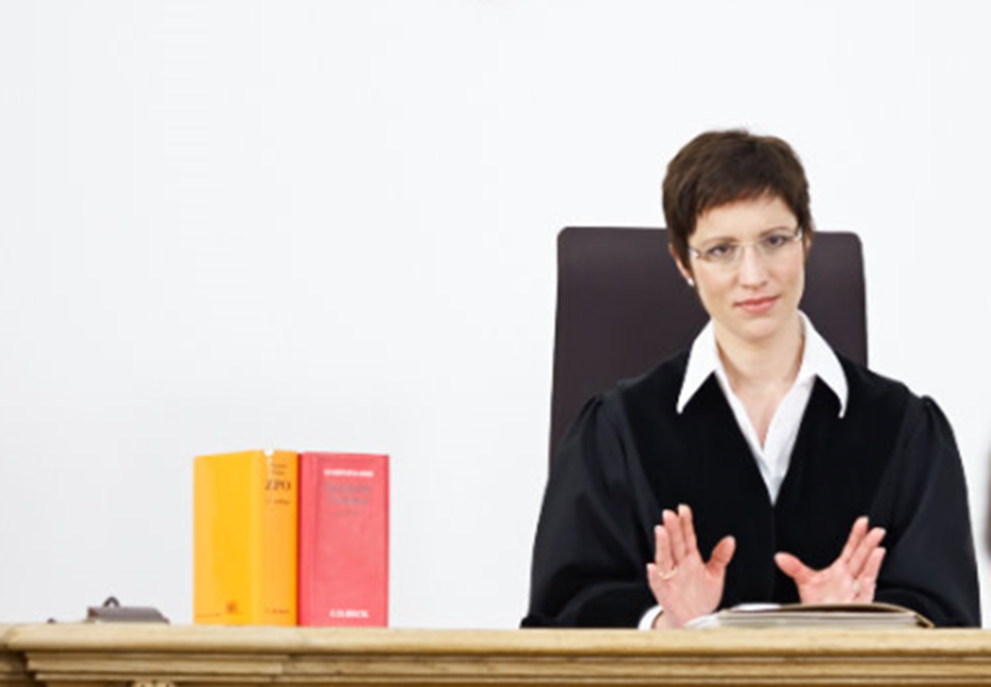
The Judge
Independence
Neutrality

Slide 3

The Judge as Mediator
Independence
Neutrality

Slide 4

Illustrative Example
Patent law: employee against employer concerning invention of medical device used in heart surgery
Credibility

Slide 5
Evaluative Tendencies
- No court costs
- Enforceable title
- Realistic process risk analysis
- Decision making mentality
- Evaluation
- Risk of a mini-trial
- Reduced creativity
- Erosion of trust

Slide 6

Illustrative Example
Copyright case: software being disputedly used by big player

Slide 7
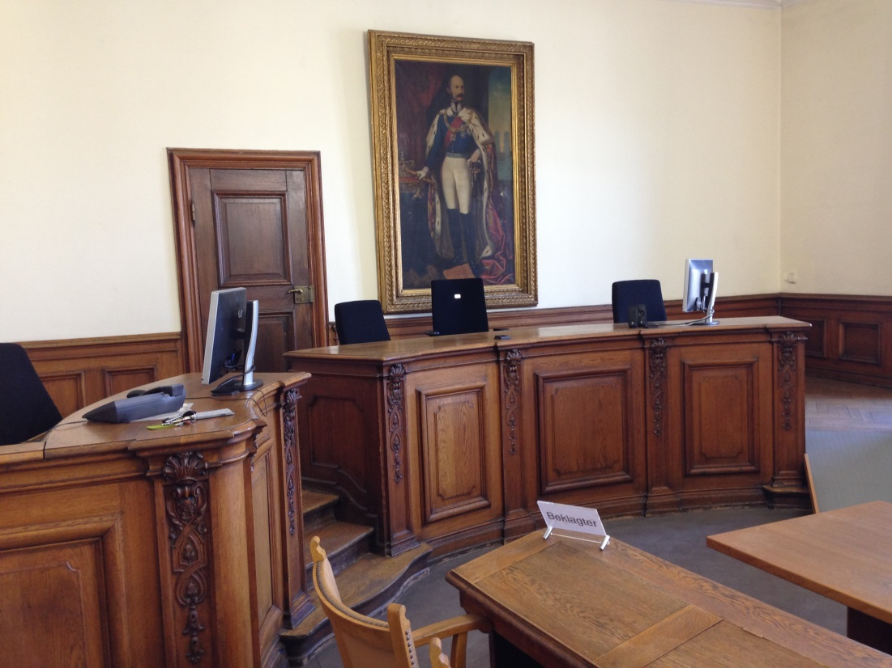
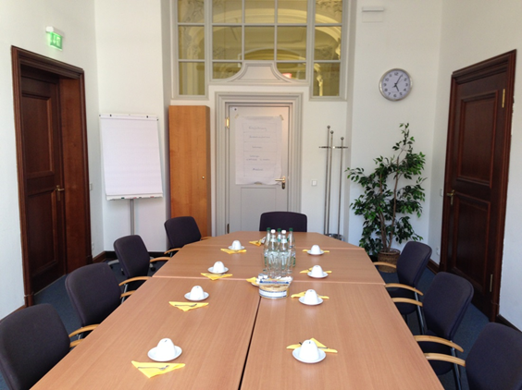



Judge -> Mediator
↔

Slide 8

Mindset
Self-awareness
Training
Collegial advice
Supervision

Slide 9

elke.schwager@lg-m1.bayern.de

